Slide 1
HIGH CLOUD AIRLINES
PRESENTING BY GROUP-6
NIHARIKA
RASIKA

Slide 2
AGENDA
INTRODUCTION
BUSSINESS OVERVIEW
OBJECTIVES
RECOMMENDATIONS AND VISUALIZATIONS
WHAT HAVE WE LEARNT FROM THIS PROJECT
CONCLUSION

Slide 3
INTRODUCTION
High Cloud Airline, a leading player in the aviation sector ,has been at the forefornt of providing seamless air travel experiences.
Establishment with a commitment to excellence, High Cloud has consistently set industry standards in terms of reliability , safety and customer satisfaction.
Extensive network of routes spans across regions ,connecting people and cultures, making High Cloud a preferred choice for millions of travelers globally.
High Cloud embraces innovation and modern technology to enhance operational efficiency and stay at the forefront of the aviation landscape.

Slide 4
BUSSINESS OVERVIEW
High cloud airlines represent a departure from conventional aviation models, leveraging cloud infrastructure and services to streamline operations, unlock new opportunities, and elevate the passenger journey . By harnessing the scalability, flexibility, and advanced capabilities of cloud platforms, these airlines aim to redefine industry standards, driving growth, and differentiation in a fiercely competitive market.
Cost Efficiency
Scalability and Flexibility
Reliability and Resilience
Customer Experience

Slide 5
OBJECTIVES
The objective of conducting the high cloud airline analysis project is to understand the data and extract insights, communicating them to clients about the airline’s performance, efficiency and condition within the aviation industry.
Secondly, Our focus was to analyzing the dataset provided, the first step involves ensuring that the data is clean and ready for analysis , once the data is prepared we can dive into exploring its structure .
Ultimately, the goal of this analysis is to extract valuable insights decisions for airlines and carriers,whether , it’s optimizing flight schedules, improving operational efficiency or understanding customer preferences.

Slide 6
BUSSINESS SUMARRY
Financial Performance
Marketing Positioning
Risk Management
High Cloud Airlines has maintained a steady financial performance, with consistent revenue growth over the past few quarters, Cost management strategies and efficient operational practices have contributed to sustaining profitability amidst competitive pressures and economic fluctuations
High Cloud Airlines has solidified its position in the market through strategic route expansion, catering to both domestic and international travelers . The company’s focus on customer satisfaction and service quality has enhanced brand loyalty and diverse customer base
High Cloud Airlines remains vigilant in managing various risks inherent in the aviation industry , including regulatory compliance geopolitical instability and fluctuating fuel prices, Robust risk management practices and contingency plans are in place to mitigate potential disruptions and ensure business continuity

Slide 7
scope
FINANCIAL ANALYSIS
MARKET ANALYSIS
OPERTIONAL ANALYSIS
CUSTOMER ANALYSIS
TECHNOLOGICAL ANALYSIS
ENVIRONMENTAL ANALYSIS

Slide 8
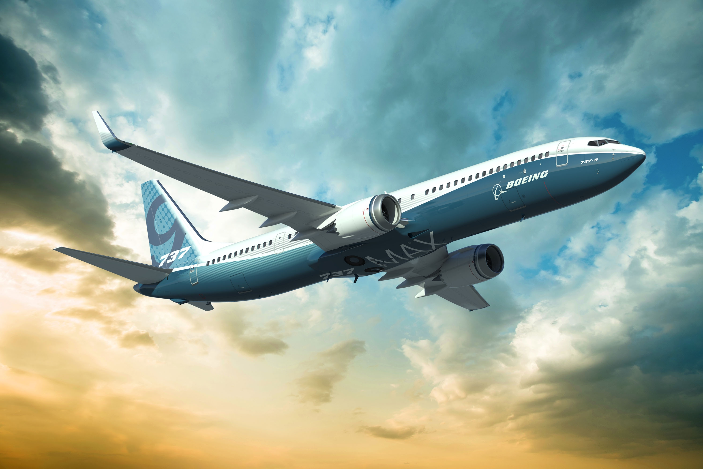
KEY INSIGHTS
FINANCIAL STABILITY:
Evaluate Overall cost structures and identify opportunities for cost optimization and efficiency improvements
COMPETITION:
Focus on intense competition, especially in popular routes
MARKET ANALYSIS:
Evaluate the performance of different carriers operating in the market and access market share
ONTIME PERFORMANCE:
Identify the overall on-time performance of flights and explore any pattern
DEMAND ANALYSIS:
Understand the performance and demand patterns across different cities, states ,countries
GROWTH OPPORTUNITES:
Identify high –demand routes and potential based on origin- destination analysis

Slide 9
RECOMMENDATIONS & VISUALISATIONS
Based on the available data it’s evident that there’s a significant preference among passengers for weekday travel compared to weekends this insights presents an opportunity for increase their flight operations within the USA ,focusing on regions or routes with high demand but low competition.
By expanding operations in these areas airlines can capitalize on untapped potential and cater to the preferences of weekday travelers.
By strategically expanding flight operations in regions or routes with high demand on weekdays, airlines can position themselves for growth and success in the competitive aviation market , This proactive approach informed by data-driven insights, can drive business expansion and enhance customer satisfaction in the long run.

Slide 10
WHAT HAVE WE LEARNT FROM THIS PROJECT?
OPERATIONAL INSIGHTS
EFFICIENCY GAINS:
we identified and implemented strategies that significantly improved trun around times and resources allocation
PROCESS IMPROVEMENT:
Enhanced workflow processes resulted in smoother operations and better overall management.
CUSTOMER EXPERIENCE
INCREASED SATISFACTION:
Feedback from our pilot testing phase indicated a marked improvement in customer satisfaction.
LOYALTY ENHANCEMENT:
The introduction of personalized services and responsive support systems and responsive support systems positively impacted customer loyalty.
TECHNOLOGY IMPLEMENTATION
SYSTEM INTEGRATION:
The integration allowed for real-time data access and improved decision – making.
CHALLENGES FACED:
Overcame initial resistance to change within in the organization
Ensured robust data security measures during and after implementation.

Slide 11
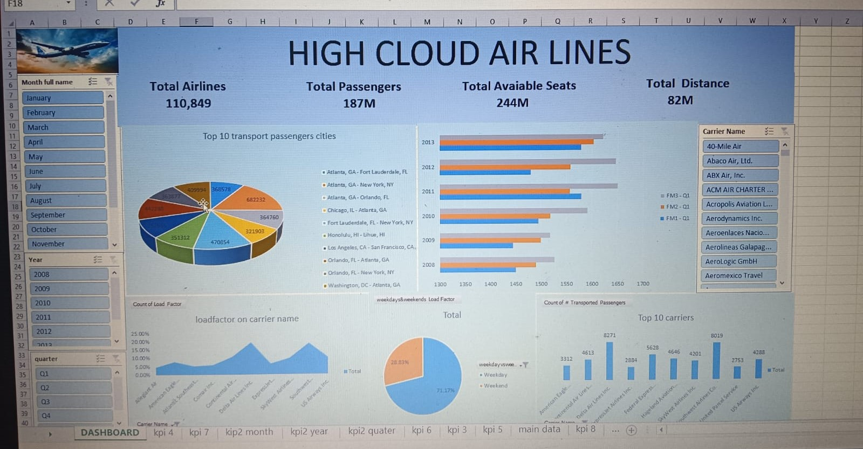
Excel dashboard

Slide 12
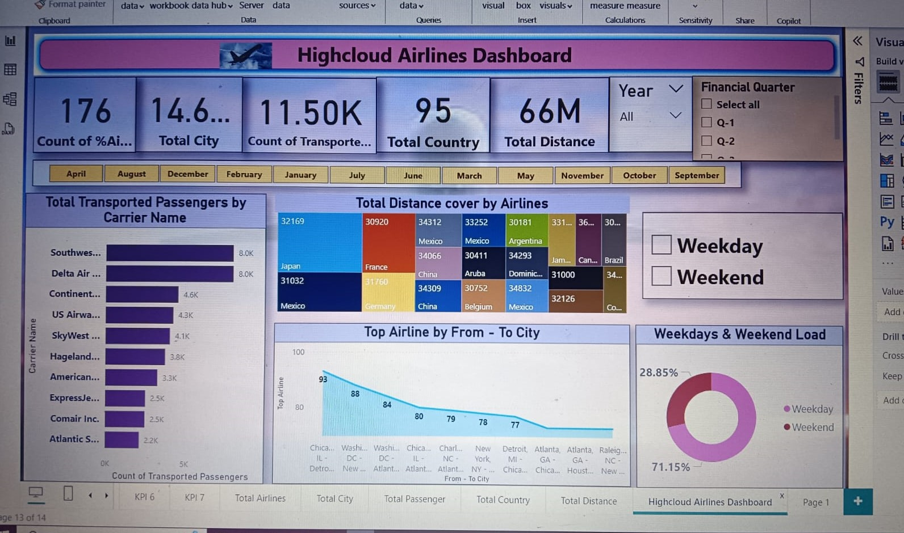
power-bi dashboard

Slide 13
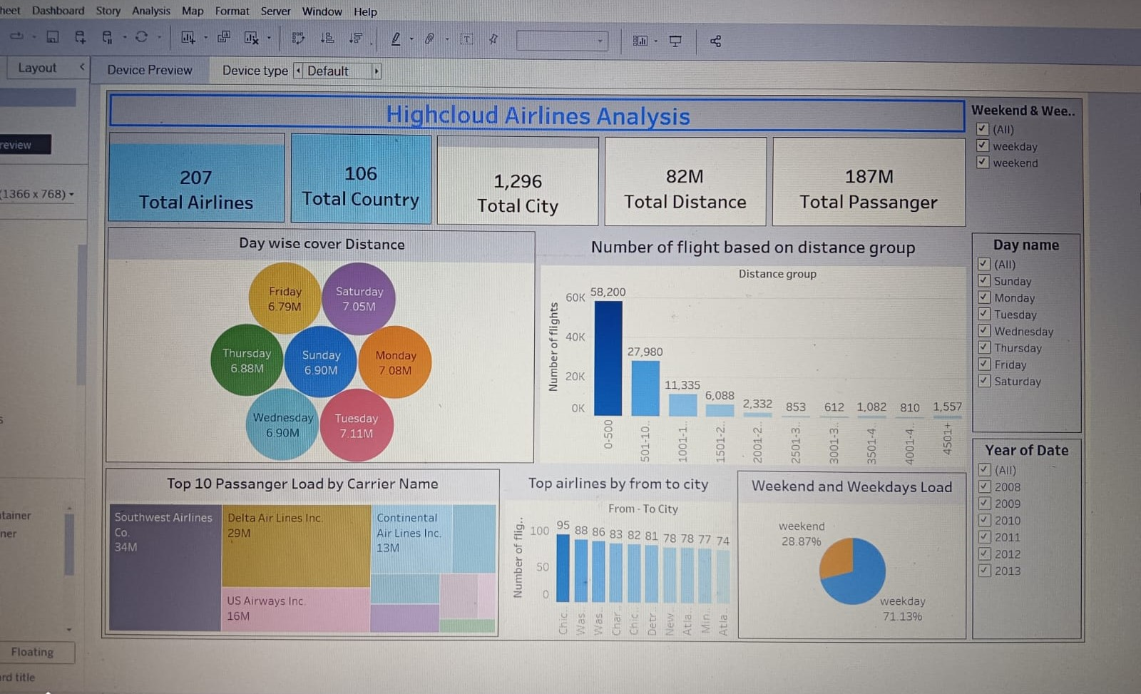
Tableau dashboard

Slide 14
CONCLUSION
The analysis of passenger travel preferences and airline performance highlights a clear opportunity for airlines to enhance their business operation.
Analyzing airline data is pivotal for driving strategic decision-making, enhancing operational efficiency and ultimately fostering the overall success and competitiveness of the airline industry.
By aligning flight schedules with passengers preferences and focusing on areas of high demand airlines can improve profitability and capitalize on growth opportunities by adopting a proactive approach informed by data-driven insights, airlines can navigate the dynamic aviation landscape with confidence, ensuring sustainable growth and success in the market.

